Slide 1
Lab 1 MIPS Programming
Overview
C programming
Load MIPS system onto FPGA board
Load the code using the UART
ftp://172.16.16.10

Slide 2
Oview
MyMIPS is a soft-core MIPS32 processor implemented on FPGA.
5-stage pipeline
5MHz

Slide 3
MyMIPS:Physical Memory
0x9FC003FF
Reset RAM
Boot Code:
Code executed at startup
(1 KB)
0x9FC00000
Unpopulated
0x80003FFF
Code / Data RAM
User Code/Data
(16 KB)
0x80000000

Slide 4
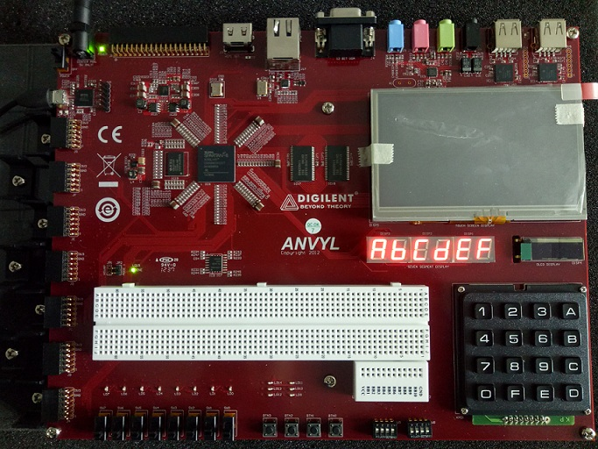
Anvyl FPGA Board

Slide 5
MyMIPS: mfp_io.h
#ifndef MFP_MEMORY_MAPPED_REGISTERS_H
#define MFP_MEMORY_MAPPED_REGISTERS_H
#define MFP_LEDS_ADDR 0xBF800000
#define MFP_SWITCHES_ADDR 0xBF800004
#define MFP_BUTTONS_ADDR 0xBF800008
#define MFP_7SEGEN_ADDR 0xBF80000c
#define MFP_7SEGDIGITS_ADDR 0xBF800010
#define MFP_LEDS (* (volatile unsigned *) MFP_LEDS_ADDR )
#define MFP_SWITCHES (* (volatile unsigned *) MFP_SWITCHES_ADDR )
#define MFP_BUTTONS (* (volatile unsigned *) MFP_BUTTONS_ADDR )
#define MFP_7SEGEN (* (volatile unsigned *) MFP_7SEGEN_ADDR )
#define MFP_7SEGDIGITS (* (volatile unsigned *) MFP_7SEGDIGITS_ADDR )
#endif

Slide 6
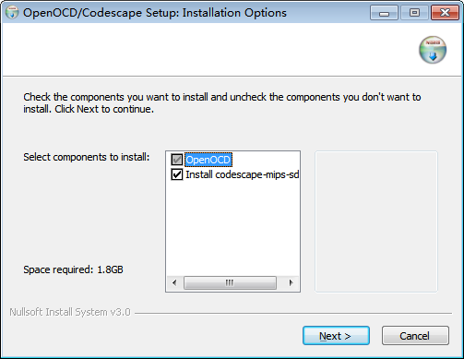
Installing Codescape(1/12)

Slide 7
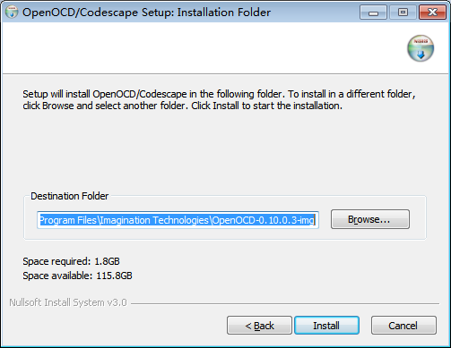
Installing Codescape(2/12)

Slide 8
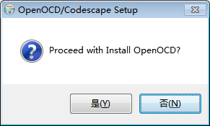
Installing Codescape(3/12)
Click Yes

Slide 9
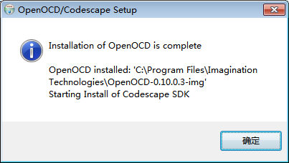
Installing Codescape(4/12)

Slide 10
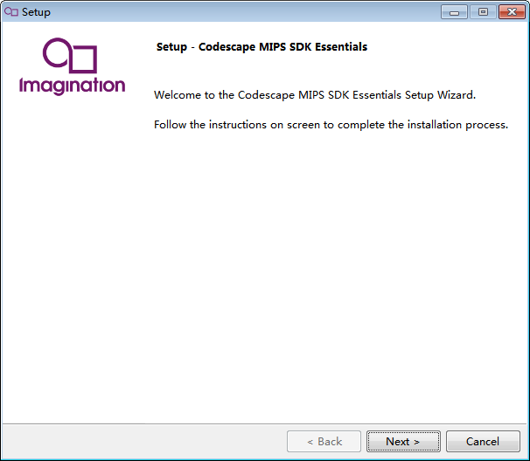
Installing Codescape(5/12)

Slide 11
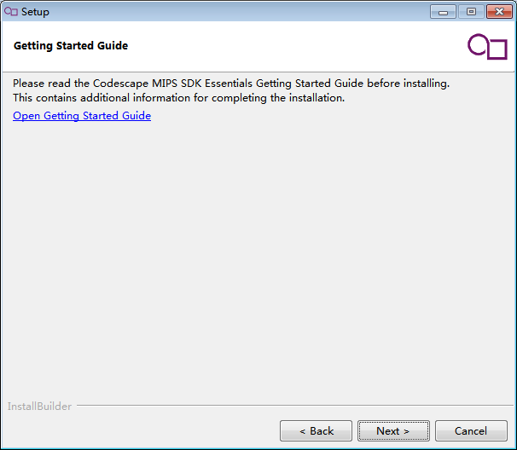
Installing Codescape(6/12)

Slide 12
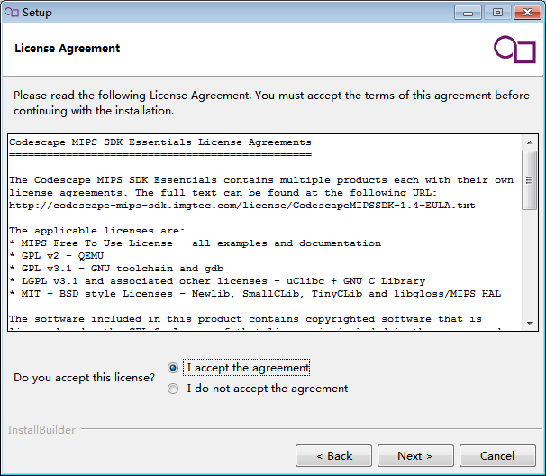
Installing Codescape(7/12)

Slide 13
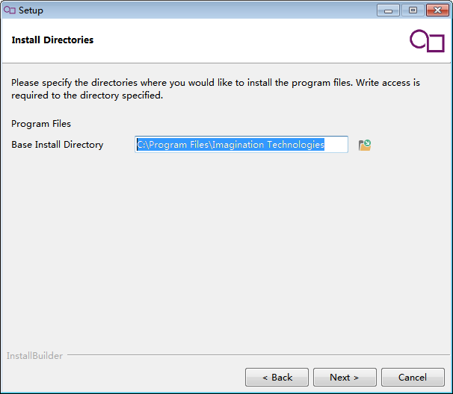
Installing Codescape(8/12)

Slide 14
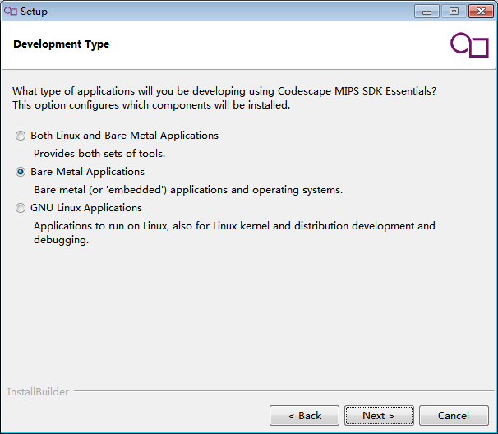
Installing Codescape(9/12)

Slide 15
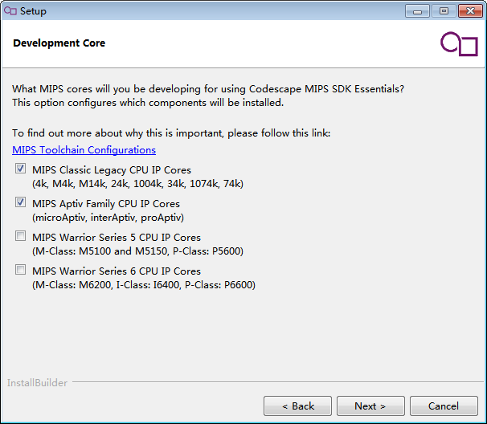
Installing Codescape(10/12)
Check on

Slide 16
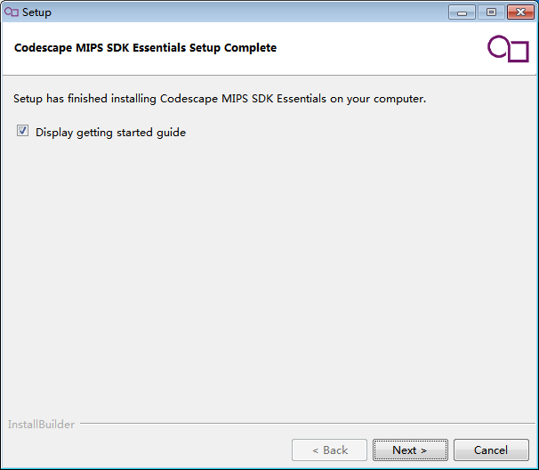
Installing Codescape(11/12)

Slide 17
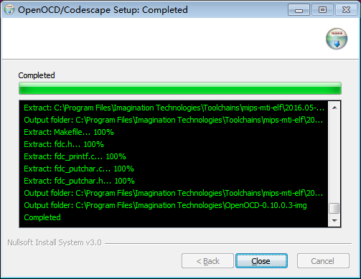
Installing Codescape(12/12)

Slide 18
C programming
Create new directory
Copy files exist in \mymips_c_template\
Create main.c
Compile project
make clean
make

Slide 19
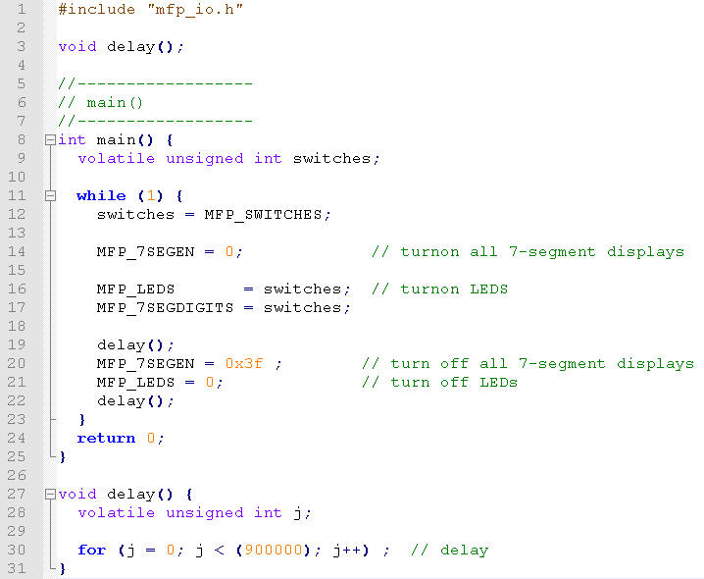
ReadSwitches:main.c

Slide 20

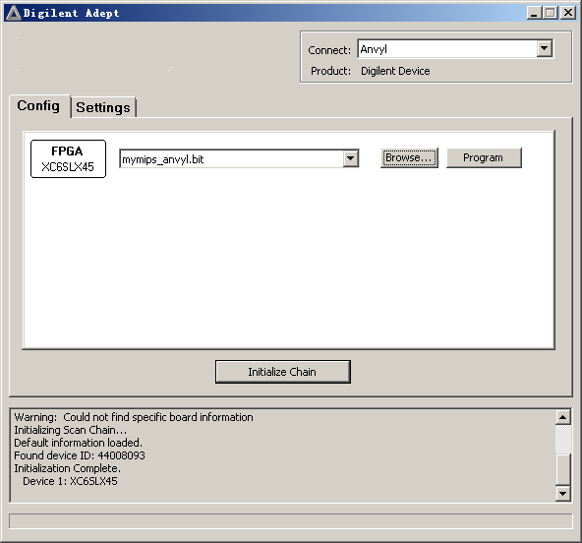
Loading MyMIPS system
Double click Adept icon, click Browse button , then click Program button.

Slide 21
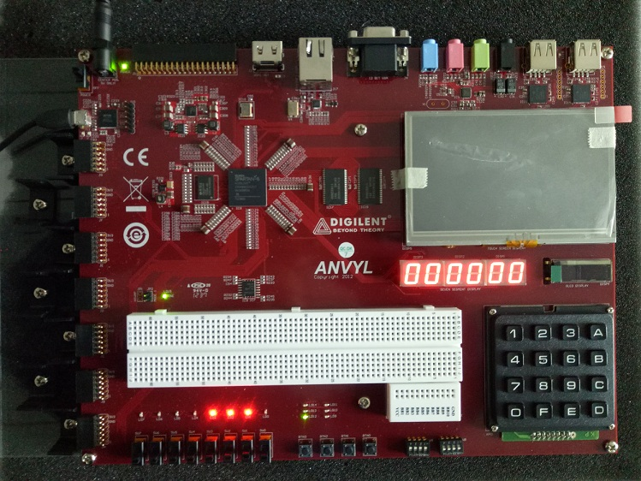

Slide 22
Loading the code using the UART
Run 6.bat
Reset the code by
Press button 3 or
Reloading the MyMIPS system and
Reloading the code

Slide 23
Programming practice
Student project
Write your own C program, compile it, and run it on MIPS. Create a program that will calculate and display the first 11 Fibonacci numbers on the LEDs. Each number in the Fibonacci series is the sum of the previous two numbers. Table 1 lists the first few numbers in the series.
n | 1 | 2 | 3 | 4 | 5 | 6 | 7 | 8 | 9 | 10 | 11 | …
fib(n) | 1 | 1 | 2 | 3 | 5 | 8 | 13 | 21 | 34 | 55 | 89 | …
fib(n) | 0x1 | 0x1 | 0x2 | 0x3 | 0x5 | 0x8 | 0xd | 0x15 | 0x22 | 0x37 | 0x59

